Slide 1
COMPUTER SUPPORTED COOPERATIVE WORK (CSCW)
Ramapriya S - 22Z251 Abinaya B - 22Z202

Slide 2
COMPUTER SUPPORTED COOPERATIVE WORK (CSCW)
CSCW is a generic term, which combines the understanding of the way people work in groups with the enabling technologies of computer networking, and associated hardware, software, services and techniques.
Computer-supported cooperative work is a groundbreaking interdisciplinary research area of growing interest which relates workstations to digitally advanced networking systems

Slide 3
COMPUTER SUPPORTED COOPERATIVE WORK (CSCW)
Groupware:
It is a software that support and augments groupwork.
Eg: Email, Bulletin boards, Group schedulers, Video conferencing, Etc.,
Group:
Group work together on a common task.
A group will not have a fixed or closed membership.

Slide 4
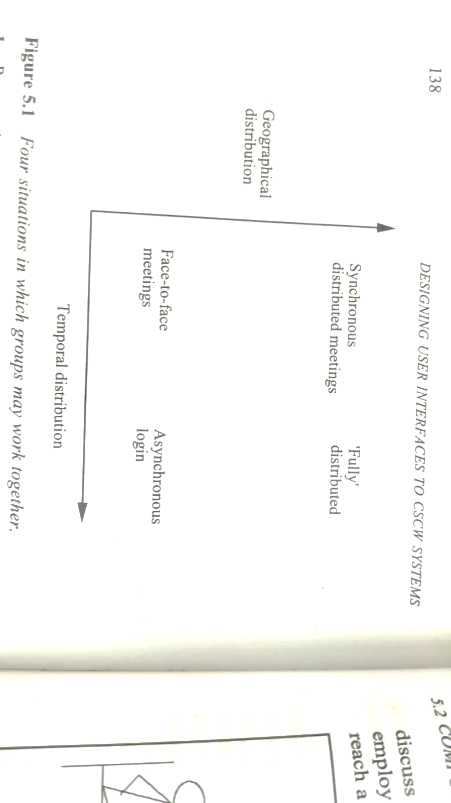
COMPUTER SUPPORT FOR GROUP WORK
Group work need not always happens face to face.
Group members need not be in the same place at the same time.

Slide 5
COMPUTER SUPPORT FOR GROUP WORK
Presentation support software
Computer Supported Meeting
Group decision Support Systems (GDSS)
Use of Telephones
Public Windows
Computer Conferencing
Group writing
Group memory management & Project management

Slide 6

PRESENTATION SUPPORT SOFTWARE

Slide 7
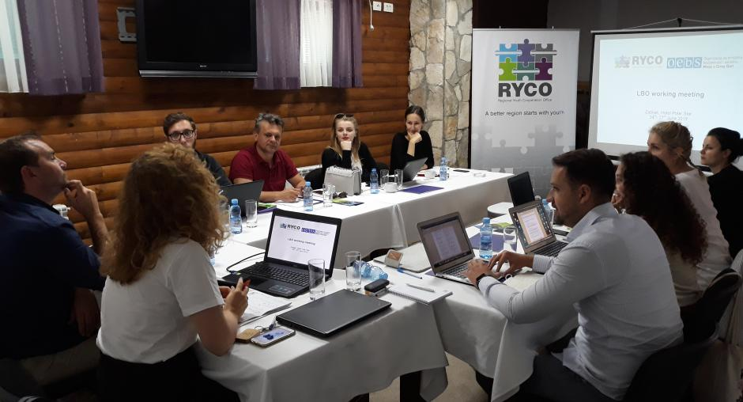
COMPUTER SUPPORTED MEETING

Slide 8

GROUP DECISION SUPPORT SYSTEMS (GDSS)

Slide 9

USE OF TELEPHONES

Slide 10
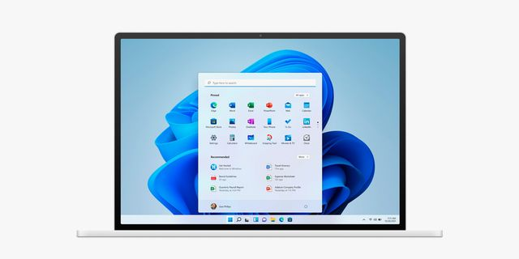
PUBLIC WINDOWS

Slide 11

COMPUTER CONFERENCING

Slide 12


GROUP WRITING
Uses computer systems to support collaboration, communication, and coordination in the shared task of producing a written document.
Notes:
Group Writing as an Application of CSCW
Co-authoring of documents
Team members collaborate on the same document.
Example: Research groups co-writing a paper on Overleaf.
Modes of collaboration
Synchronous (real-time, all online together).
Example: Google Docs live editing.
Asynchronous (distributed, different times).
Example: Using GitHub for documentation or wikis.
Workspaces
Private workspace → members draft ideas individually.
Public window → shows the shared document state visible to everyone.
Revision tracking
System records who made which changes.
Example: “Version history” in Google Docs or MS Word Track Changes.
Non-destructive editing
Suggested changes don’t overwrite the original text → safer collaboration.
Example: Comment/suggest mode in Docs, “Pull Requests” in GitHub.
Comparison of drafts
Multiple versions can be compared side by side for better decision-making.
Goal
Speed: Faster completion of documents.
Quality: Improved accuracy and richness through multiple perspectives.

Slide 13
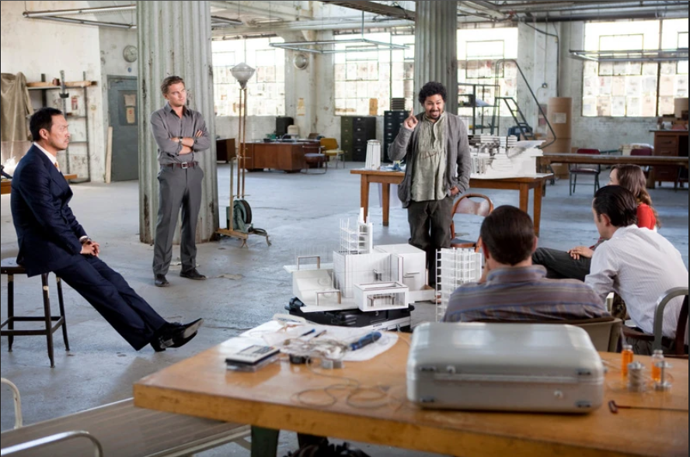
GROUP MEMORY MANAGEMENT & PROJECT MANAGEMENT
Helps teams remember past ideas, statements, and decisions.
"An idea is like a virus, resilient, highly contagious and the smallest seed of an idea can grow. It can grow to define or destroy you"
Notes:
Group Memory Management & Project Management in CSCW
Group Memory Management
Helps teams remember past ideas, statements, and decisions.
Stores notes from meetings with links between words, concepts, and people.
Example:
Slack / MS Teams → searchable chat history.
Confluence / Notion → structured team knowledge base.
Scenario
“I remember it was Susan’s idea about optimization a few days ago.”
CSCW tools allow quick retrieval of such past discussions.
Project Management Support
Assists in planning, task allocation, and progress tracking.
Helps coordinate the activities of individual members in a shared project.
Examples
Trello / Asana → task boards for visual planning.
Jira → software project tracking.
MS Project → timelines & Gantt charts.
Goals
Avoids loss of ideas in group discussions.
Improves team coordination and ensures deadlines are met.

Slide 14
CHARACTERISTICS OF CSCW SYSTEM
Communication between the group members
Sharing of Information
Coordination and control of shared objects
Sharing of workspace
Organization and common understanding of the work process
Decision making
Notes:
Communication between group members CSCW systems enable smooth interaction through chat, video calls, or messaging. This ensures team members can discuss and clarify ideas in real time.
Sharing of Information Members can easily exchange files, documents, and updates. This helps keep everyone on the same page with the latest knowledge.
Coordination and control of shared objects CSCW tools manage simultaneous access to shared documents or data. They prevent conflicts and maintain version control.
Sharing of workspace A common digital space allows members to work together virtually. Example: Google Docs or collaborative whiteboards.
Organization and common understanding of the work process Systems help structure tasks, workflows, and responsibilities. This creates clarity about “who does what” in the project.
Decision making CSCW supports joint discussions, voting, and consensus-building. This leads to better and more democratic team decisions.

Slide 15
ROLE OF CSCW USER INTERFACE
Support interaction between user and system in order that user can achieve his or her individual task.
Support interaction between user and system in order that user can achieve his or her part of common task in the group
Supporting social interaction between the group members.
Notes:
Support individual tasks
The interface should let each user easily interact with the system to complete their own personal tasks.
Example: In Google Docs, you can independently edit your assigned section without disturbance.
Support group/common tasks
The interface must also allow users to perform their part of the shared task, contributing to the group’s overall goal.
Example: In Trello, you manage your cards, but the whole board reflects team progress.
Support social interaction
Since CSCW is about cooperation, the interface should enable communication and awareness among members.
Example: Comments, chats, mentions, and presence indicators (“A is editing slide 3”) in tools like MS Teams or Docs.

Slide 16
CHARACTERISTICS OF CSCW USER INTERFACE
Order dependency
Order Independence
Multithreading
Concurrency
Sociability
Notes:
Order Dependency
Some actions must follow a strict sequence to avoid errors.
Example: In document editing, you must insert a section before formatting it.
Order Independence
Tasks can be done in any order without affecting the outcome.
Example: Two people adding comments in different parts of a Google Doc.
Multithreading
The system supports multiple tasks happening simultaneously.
Example: Editing text while uploading a file in Slack.
Concurrency
Multiple users can work on the same shared object at the same time.
Example: Real-time collaboration in MS Teams whiteboard.
Sociability
The interface should support social cues and interactions among members.
Example: Emojis, presence indicators (“A is typing…”), and chat in collaborative platforms.

Slide 17
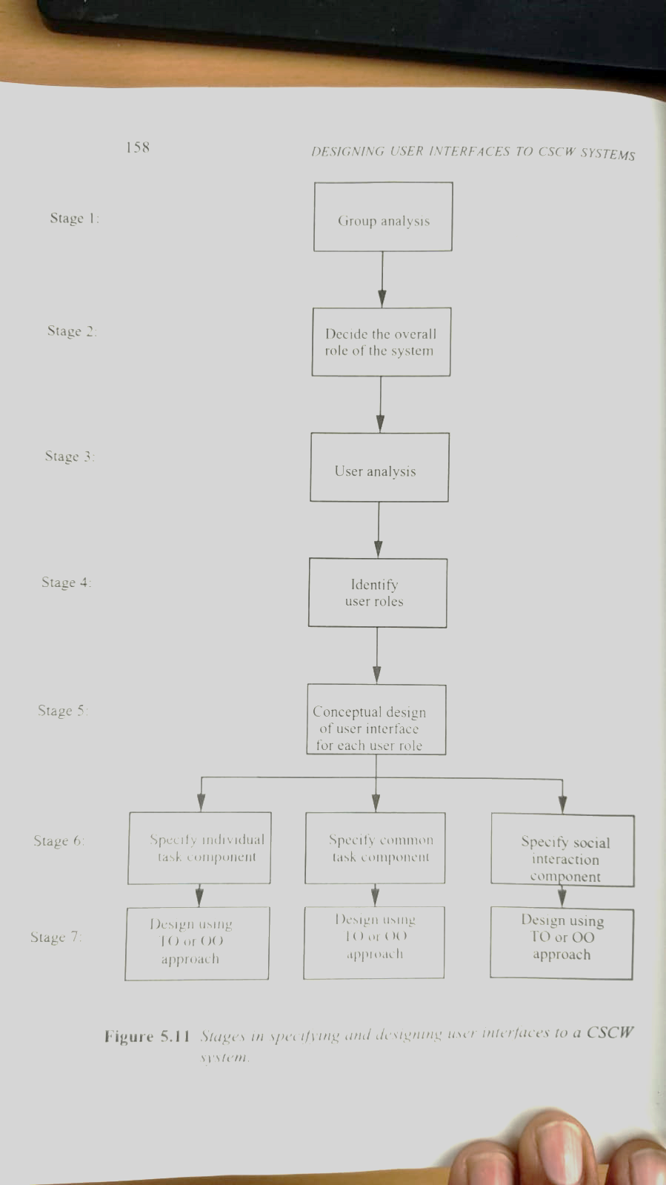
STAGES IN SPECIFYING & DESIGNING USER INTERFACE TO A CSCW SYSTEM

Slide 18
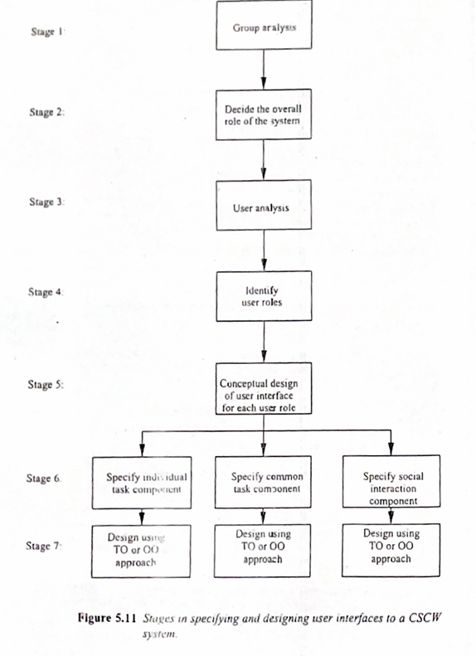
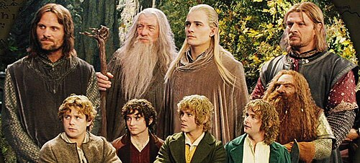

Slide 19
CSCW User Interface Design

Slide 20
THANK YOU

